Slide 1

Fake News Detection Project (Using NLP)
SUBMITTED BY:
ANIRUDH SHUKLA 00619011921
ASHISH KUMAR 01419011921
B DHRUV 03519011921
HARDIK SINGH 06819011921

Slide 2

INTRODUCTION 1. What is Fake News Detection? 2. Importance of Fake News Detection. REQUIREMENTS 1. Hardware Requirements. 2. Software Requirements. 3. Tools, Libraries and Packages used. 4. Data sources. 5. Pre-Assumptions. 6. Data Pre-Processing. ML MODEL DEVELOPMENT & EVALUATION 1. Problem Identification. 2. Listing of ML Models. 3. Processing the Data-set for Training and Testing. 4. Evaluation of ML Models. 5. Hyper Tuning of the ML Model. 6. Final Results. Conclusion

Slide 3
What is Fake News Detection?
Against the changes the world is currently facing, an increasing number of daily tasks are moving online, including reading the news and being informed about relevant topics. The increase in the volume of information made available led, in turn, to fake news dissemination becoming a trending topic on the Internet. Recent events such as the pandemic have shown that “Fake news exerts a significant negative influence on societies by highlighting stories that do not necessarily report on facts”. Research communities expressed concern about this flood of misinformation and introduced automated fake news identification solutions based on Natural Language Processing (NLP) techniques. In this study, we reference existing datasets and related work in the analysis of English fake news, discuss potential detection techniques for Fake news, as well as establish future work plans for this research initiative.

Slide 4
Importance of Fake News Detection.
News media has become a channel to pass on the information of what’s happening in the world to the people living. Often people perceive whatever conveyed in the news to be true. There were circumstances where even the news channels acknowledged that their news is not true as they wrote. But some news has a significant impact not only on the people or government but also on the economy. One news can shift the curves up and down depending on the emotions of people and political situation.
“Fake news serves to misinform people and manipulate their opinions for several reasons”.
It is important to identify the fake news from the real true news. The problem has been taken over and resolved with the help of Natural Language Processing tools which help us identify fake or true news based on historical data.

Slide 5
Hardware Requirements
A mid level computer that runs on Intel i3/i5/i7 or A10/A11/M1 or ryzen 3/5 or any other equivalent chipset and a suitable processor.
Software Requirements
Windows / Linux /Mac OS

Slide 6
Tools, Libraries and Packages used
Tool: 1.Anaconda Navigator.
2. Jupyter Notebook.
Libraries and Packages:
1. NumPy.
2. Pandas.
3. Matplotlib.
4. Seaborn.
5. NLTK and its derivatives.
6. Regex expressions.
7. String.
8. Classification ML models.

Slide 7
Dataset:
The dataset consists of two CSV files. The first file named “True.csv” contains more than 12,600 articles from reuter.com.
The second file named “Fake.csv” contains more than 12,600 articles from different fake news outlet resources.
Each article contains the following information: article title, text, type and the date the article was published on.
The data collected were cleaned and processed, however, the punctuations and mistakes that existed in the fake news were kept in the text.

Slide 8
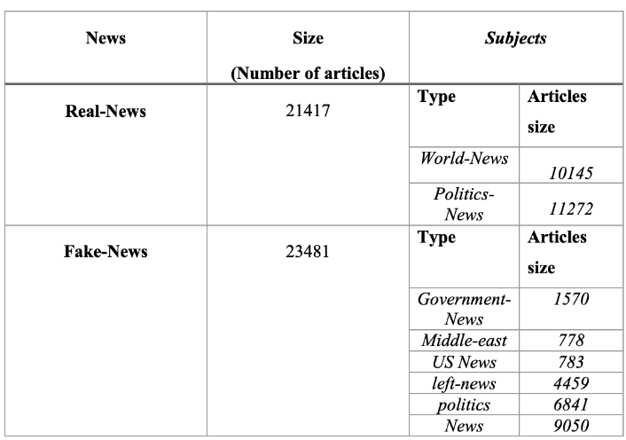

Slide 9
Data Pre- Processing
Here we will try to make the given data-set efficient for the ML model. For that we will carry out a series of process which will make the data-set perfect for building a ML model. This series of process includes,
Collection of basic statistical data.
Exploratory data analysis.
Text Data Pre-Processing.
Text Data Vectorization.
By following these processes we can achieve a more efficient data-set. We will use Python through Jupyter notebook for data processing. Also we will use Libraries such as Pandas, Numpy for Analysis and Matplotlib, seaborn for visualization.

Slide 10
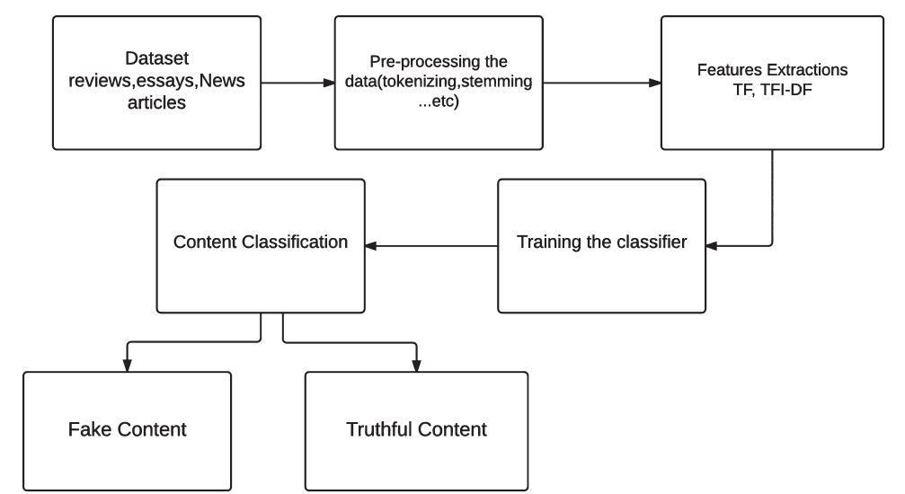

Slide 11
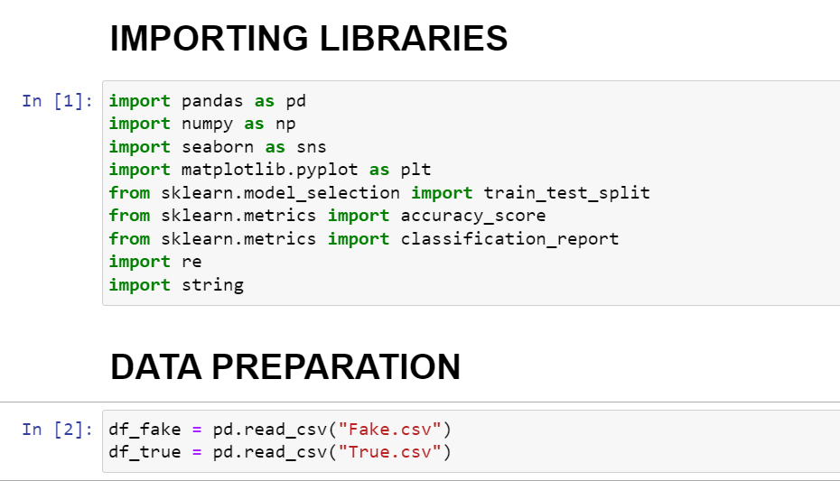

Slide 12
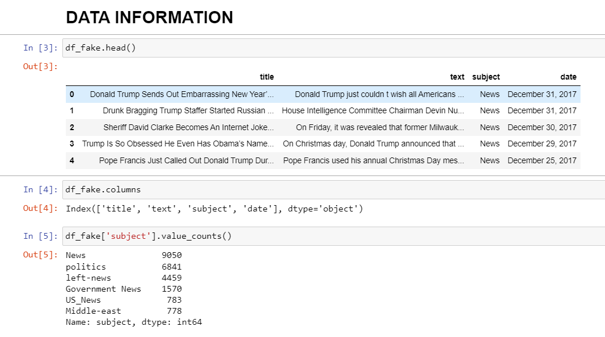

Slide 13
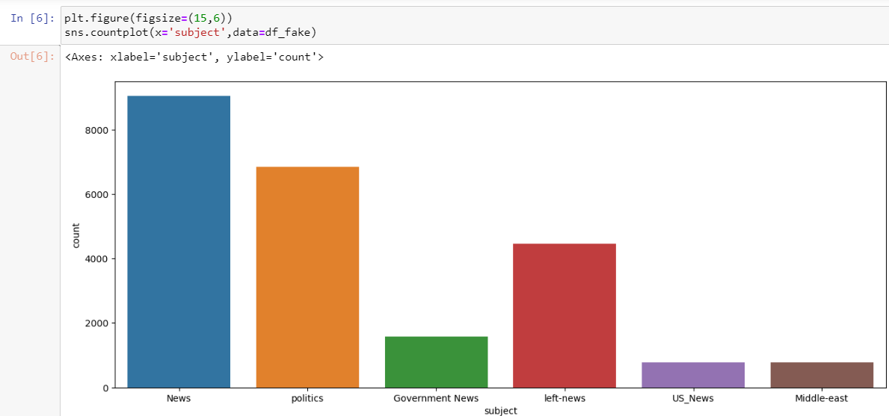

Slide 14
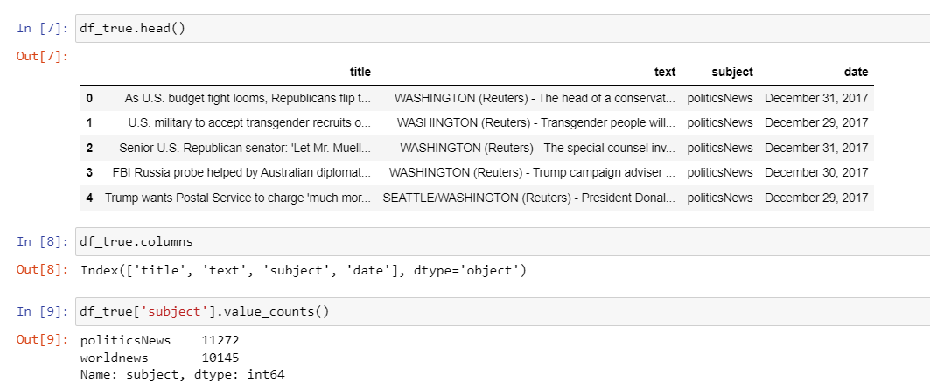

Slide 15
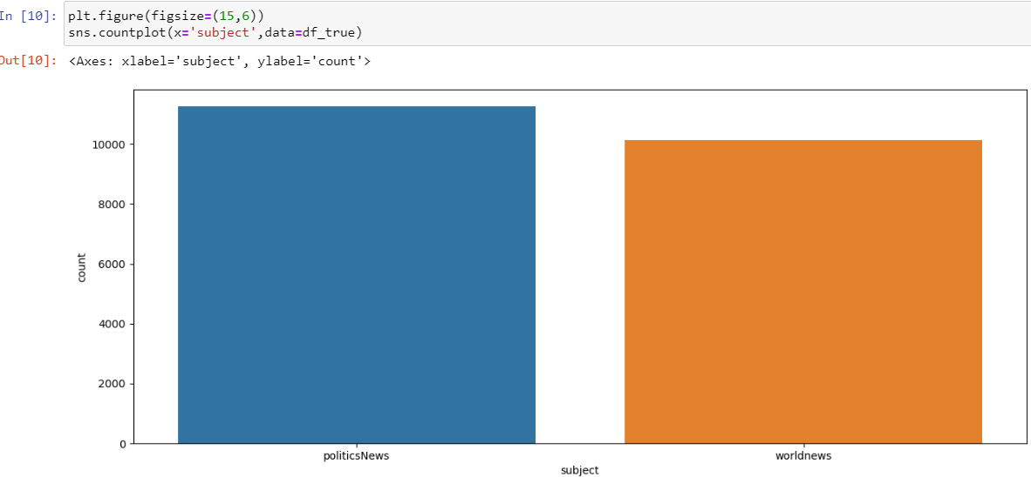

Slide 16
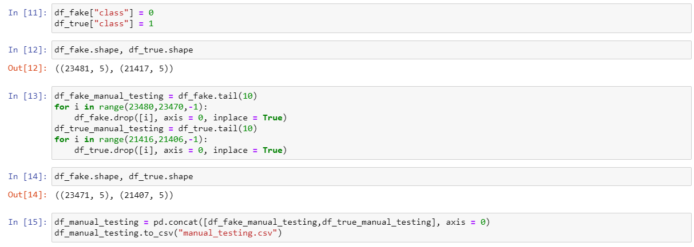

Slide 17
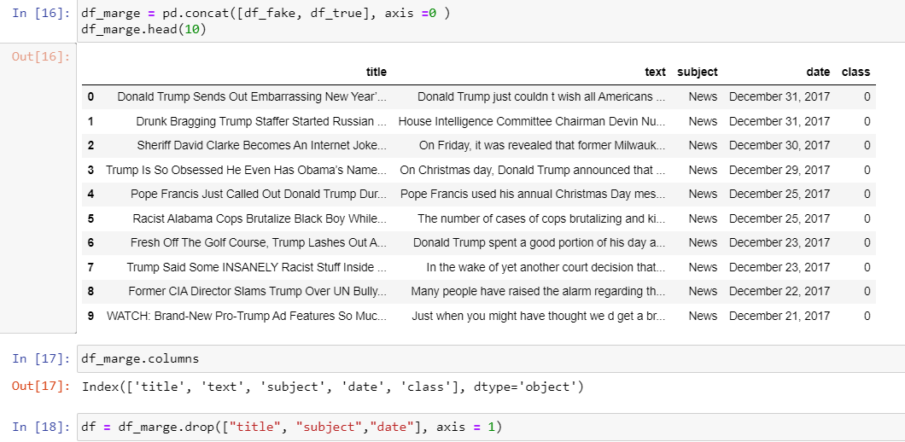

Slide 18
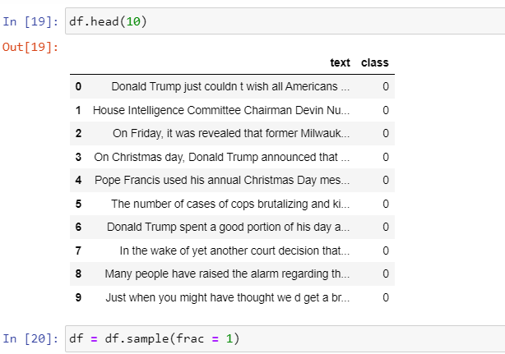

Slide 19
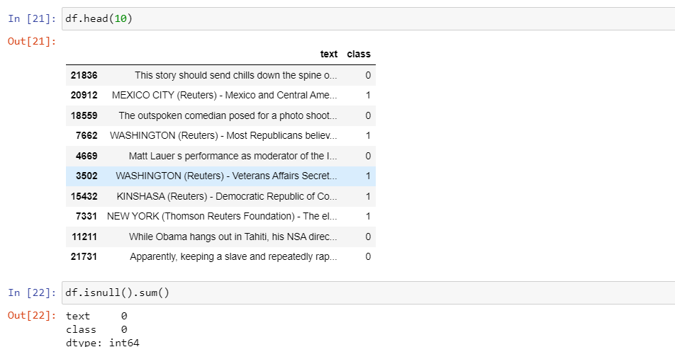

Slide 20
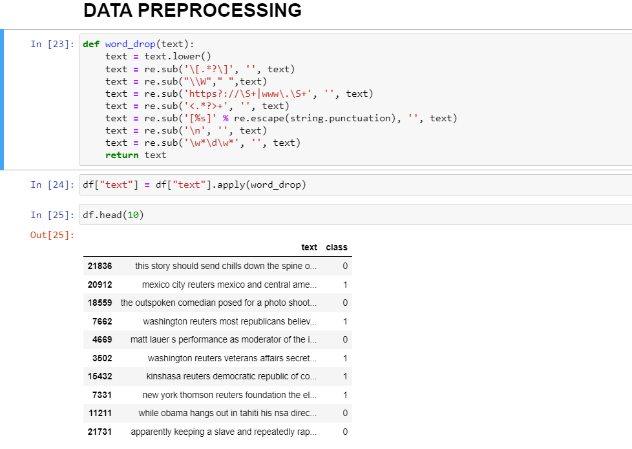

Slide 21
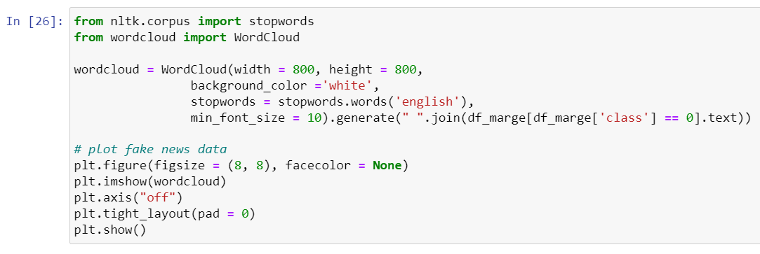
FAKE-NEWS WORD CLOUD

Slide 22


Slide 23
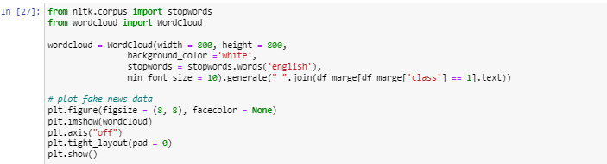
TRUE-NEWS WORD CLOUD

Slide 24


Slide 25
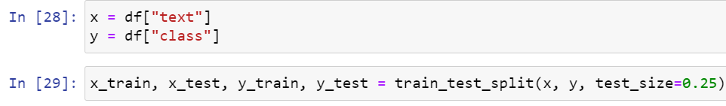

Slide 26
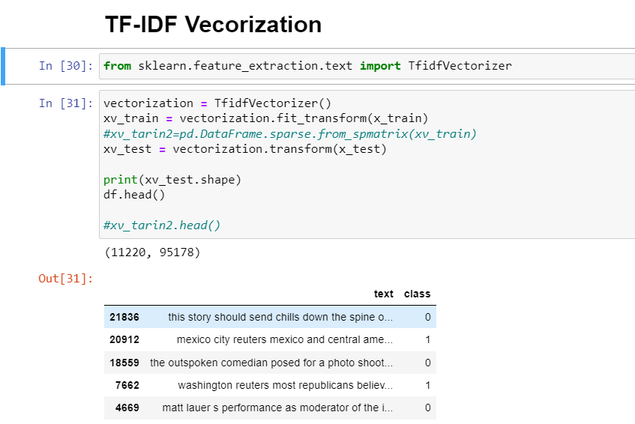

Slide 27
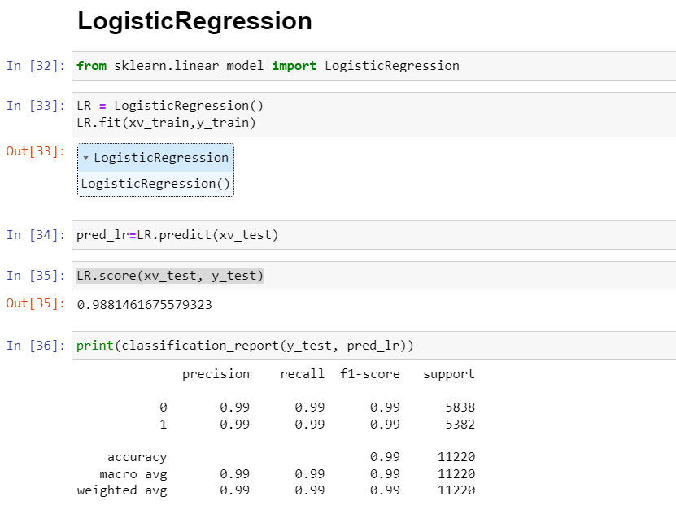

Slide 28
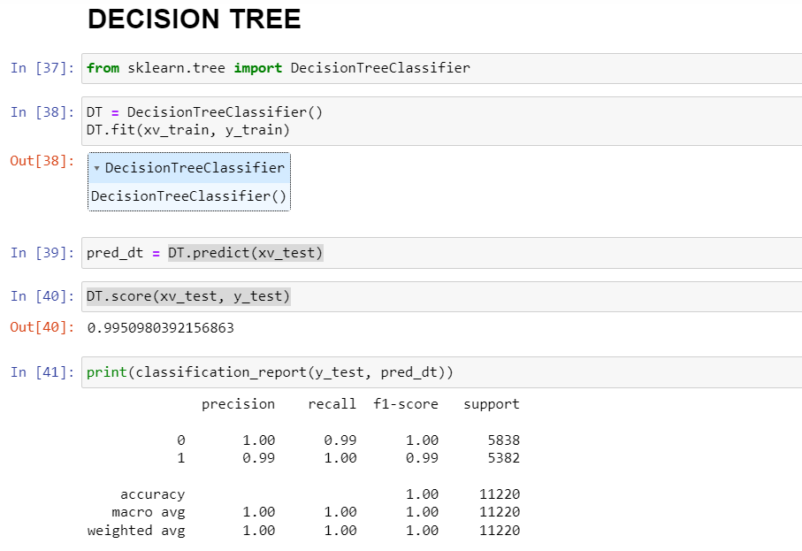

Slide 29
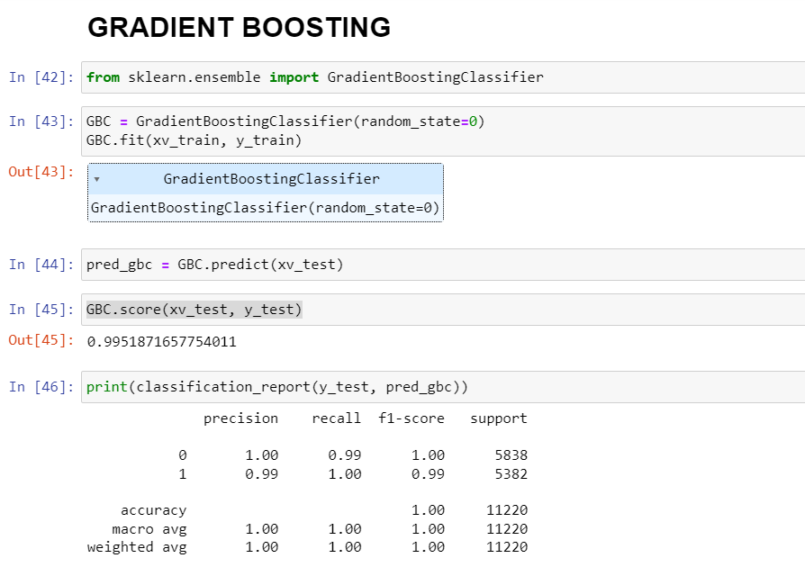

Slide 30
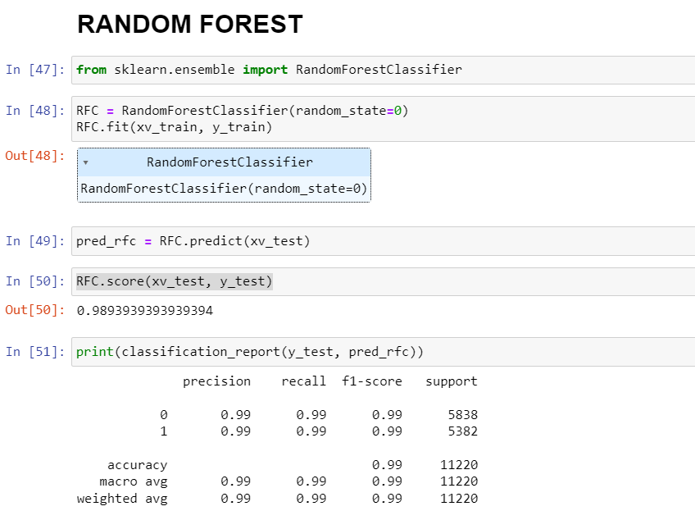

Slide 31
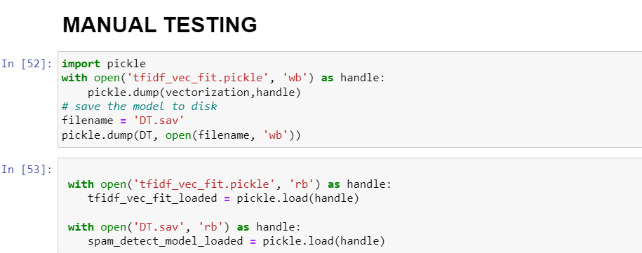

Slide 32
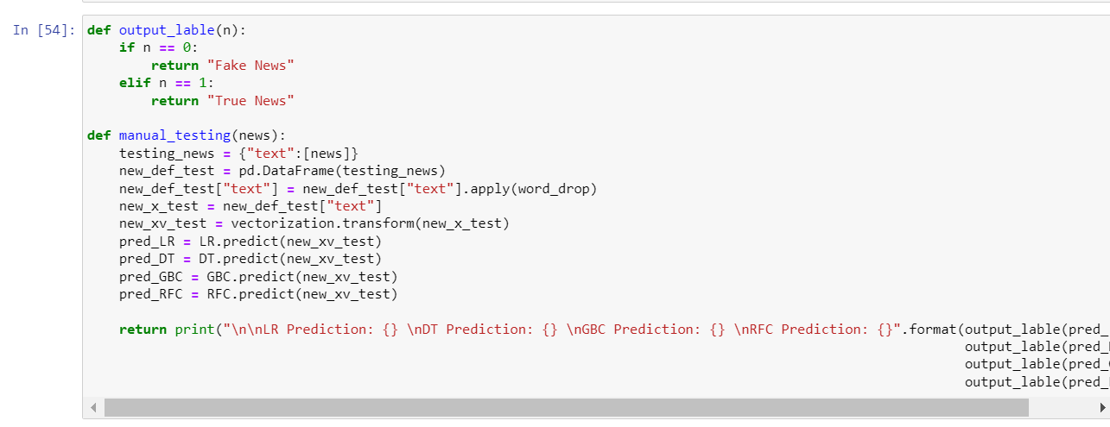

Slide 33
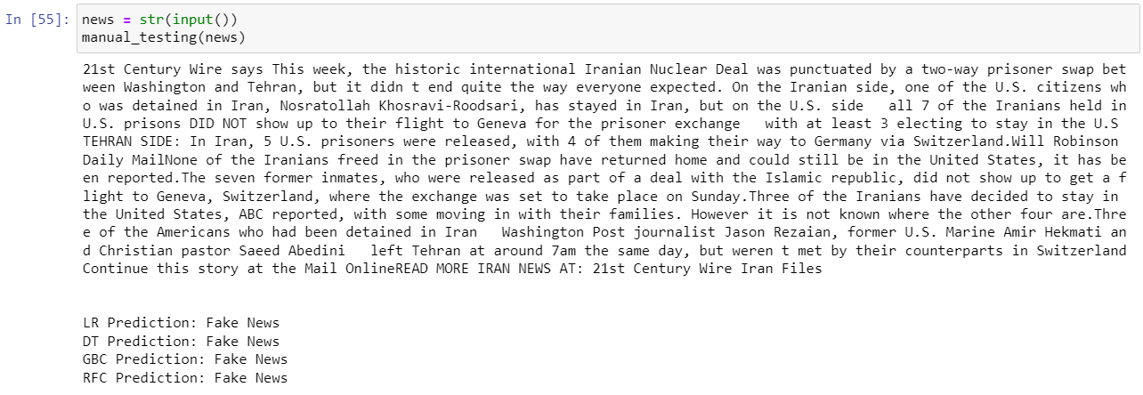

Slide 34
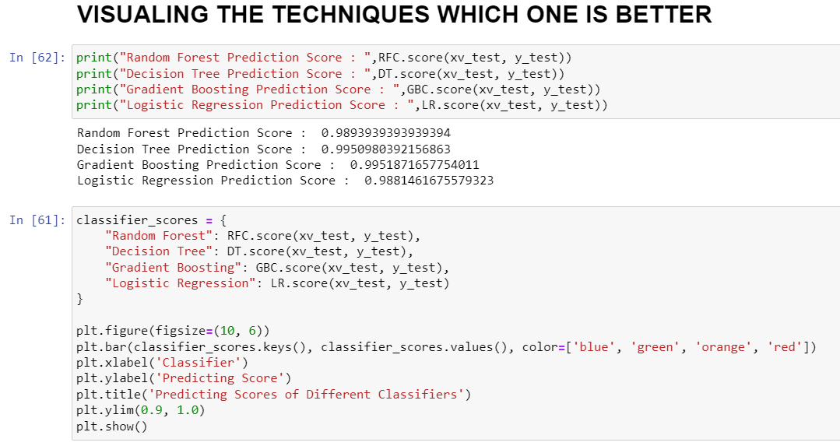
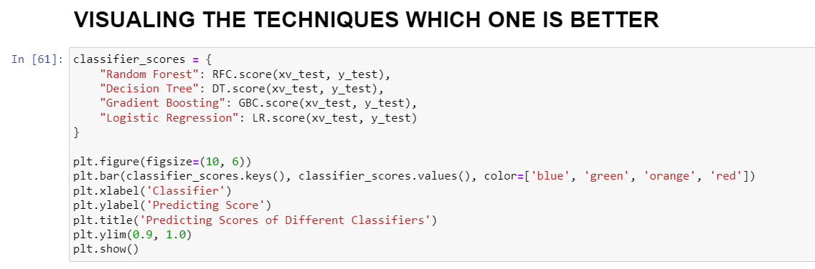

Slide 35
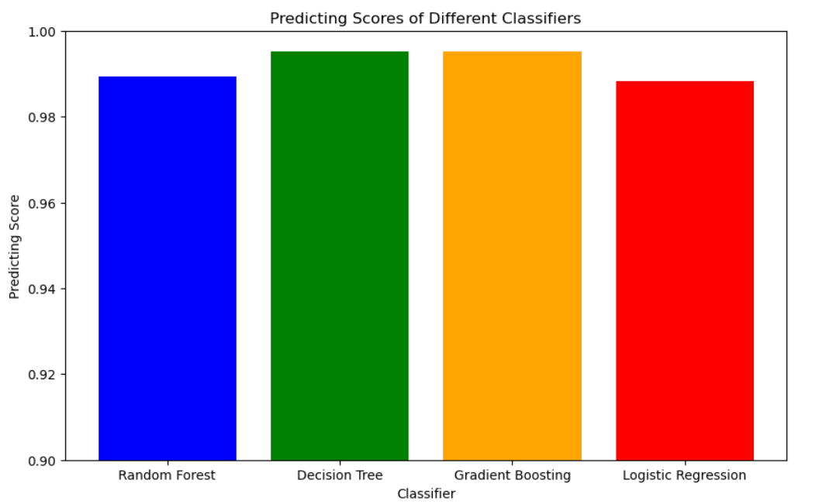

Slide 36
CONCLUSION:
The “Gradient boosting" works well with the given dataset.
The manual testing gives a very positive result.

Slide 37
Limitations:
Lack of more information leads to minimized usage of the ML models potential.
More feature engineering is need for the data-set.
With the help of more supporting information the model can be used efficiently for all news sectors.

